Slide 1
Christmas Warmups
Hull Music Service
Putting Music At The Heart Of Hull

Slide 2
Focus: Body/Mind Coordination
Christmas Selection Box
Santa: Hands on belly, say “Ho, Ho, Ho”
Candy Cane: Make a shape like a candy cane
Snowflake: Do a star jump
Hang the Stocking: Stretch to hang a stocking
Christmas tree: Legs wide, hands up together
Last minute shopping: Run on the spot
Mistletoe: Hug yourself
Snow Angel: Make wing shapes with your arms
Reindeer: Make antlers with your hands and prance
Fairy Lights: Make blinking star shapes with hands
Wrap presents: Cover your self in imaginary paper from top to toe as quick as you can!
How to play:
Leader: Say one of the commands
Class: Do the matching action

Slide 3
Focus: Vocal Warm Up
Christmas Eve Sound Story
It was Christmas Eve and Father Christmas was flying on his sleigh, through the sky. ‘Zoom’ The snow was falling. The wind was blowing. ‘Whoosh” Father Christmas pointed his sleigh at a roof and headed down to land. ‘Siren down, thud!’ He crept across the snowy roof with crunching footsteps.‘Crunch’ Looking at the chimney, Father Christmas was worried he would fit down. ‘Uh – Oh’ He tapped his nose three times ‘Ding, Ding, Ding’ and hoped for the best, sliding down the chimney. ‘Siren down, thud!’ He listened to check everyone was asleep ‘Snore’ The first thing he saw was a steaming mince pie. ‘Mmmmm’ He took a bite but it was really hot! ‘Pant and fan mouth’ He took a drink of milk to cool his mouth down. ‘Glug’ He quickly chewed the rest of the pie ‘Chew’ and then went to put the presents under the tree. Suddenly, he heard a sigh and a yawn. ‘Sigh and yawn’ Someone was awake! Quick as a flash he scooped up his bag, ‘Scoop up’ tapped his nose ‘Ding, Ding, Ding’ and slid up the chimney ‘siren up – ping!’ Flying away on his sleigh he laughed jollily, wishing all a Merry Christmas ‘Ho, Ho, Ho, Merry Christmas!’
Read the story and click on the speaker phone to hear the sounds.
Repeat each sound with your voices.

Slide 4
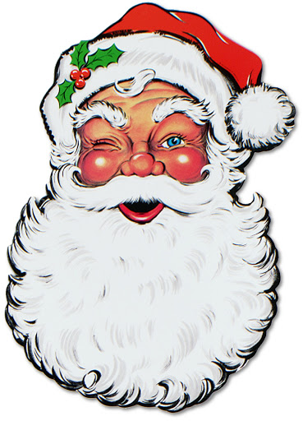
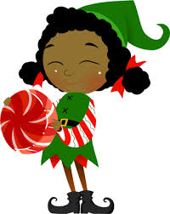
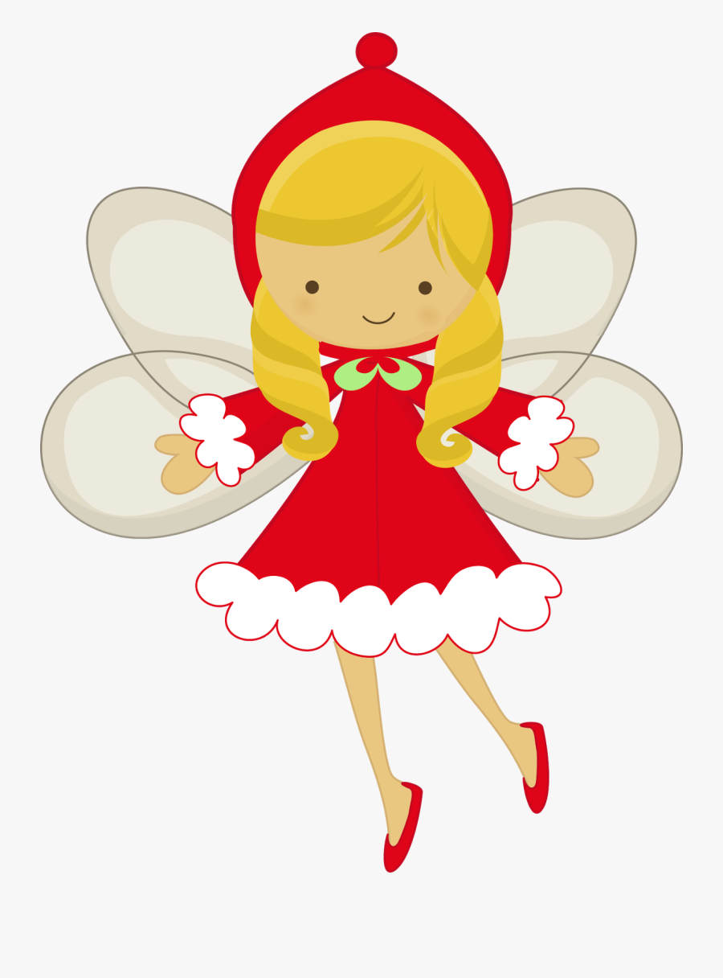
Focus: Vocal qualities/resonance
Christmas Laughs
Let’s have a laugh with these Christmas favourites.
Have a go at copying their laughs. Try to make your voice sound different each time.
Father Christmas
Mrs Christmas
Christmas Elf
Christmas Fairy

Slide 5
Focus: Vocal qualities/resonance
Christmas Silly Singing
Try to sing these Christmas ‘jingles’ in the same different voices.
Father Christmas Sing ‘Ho, Ho, Ho, its Christmas!’
Mrs Christmas Sing ‘Jingle Bells’
Christmas Elf Sing ‘Rudolph’
Christmas Fairy Sing ‘Ding dong’

Slide 6
Focus: Pitched warm up and diction
Christmas Bells – Call & Response
Listen to the call and sing the response
Call: Christmas bells are ringing
Response: Ding, dong, ding, dong, ding, dong, ding
Pretty presents perfectly packed in patterned paper
Santa’s Sleigh Shoots Swiftly speeding through the Starry Sky
Try these tongue twisters

